Slide 1
E-COMMERCE WEBSITE
LIFESTYLE STORE
DETAILED DEVELOPER REPORT

Slide 2
Security Status – Extremely Vulnerable
Hacker can steal all the records of Lifestyle Store.(SQLi)
Hacker can take control of complete server including View, Add, Edit, Delete files and folders.(Shell Upload and weak password)
Hacker can change source code of application to host malware, phishing pages or even explicit content. (Shell Upload)
Hacker can see details of any customer. (IDOR)
Hacker can easily access or bypass admin account authentication.(Burteforcing)
Hacker can get access to seller details and login into the website using customer of the month username.(PII)
Hacker can change the password, confirm order and remove item of customer.(CSRF)

Slide 3
Vulnerability Statistics
Critical
14
Severe
10
Moderate
7
Low
5

Slide 4
Vulnerabilities:
NO | SEVERITY | VULNERABILITY | COUNT
1 | CRITICAL | SQL Injection | 3
2 | CRITICAL | Access to admin panel | 1
3 | CRITICAL | Arbitrary FILE UPLOAD | 2
4 | CRITICAL | Account takeover by OTP Bypass | 1
5 | CRITICAL | CSRF | 3
6 | SEVERE | REFLECTED Cross site scripting | 1
7 | SEVERE | STORED Cross site scripting | 1
8 | SEVERE | Common Password | 1
9 | SEVERE | Component with Known Vulnerability | 3
10 | MODERATE | Server Misconfiguration | 1
11 | MODERATE | Unauthorized access to user details (IDOR) | 4
12 | MODERATE | Directory Listings | 5
13 | LOW | Personal Information Leakage (PII) | 2
14 | LOW | Client side and Server side validation Bypass | 1
15 | LOW | Default Error Display | 1
16 | LOW | Open Redirection | 2

Slide 5
1. SQL Injection
SQL Injection (Critical) | Below mentioned URL in the T-shirt/socks/shoes module is vulnerable to SQL injection attack Affected URL : http://13.232.196.71/products.php?cat=1 Affected Parameters : cat (GET parameter) Payload: Cat=1’ Affected URL : http://13.235.115.178/products.php?q=socks Affected Parameters : q (GET parameter) Payload : q=socks’

Slide 6
SQL Injection (Critical) | Here are other similar SQLi in the application Affected URL : http://13.232.196.71/products.php?cat=2 http://13.232.196.71/produts.php?cat=3

Slide 7
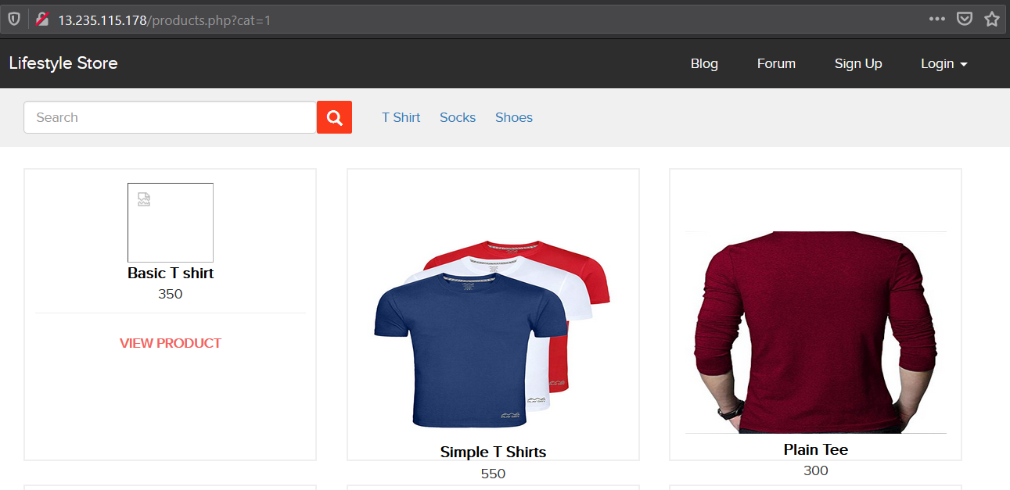
Observation
Navigate to T-shirt tab where you will see number of T-shirts. Notice the GET parameter CAT in URL:

Slide 8
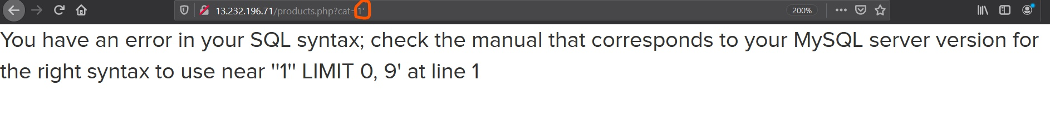
Observation
We apply single quote in cat parameter: products.php?cat=1’ and we get complete MYSQL error:

Slide 9
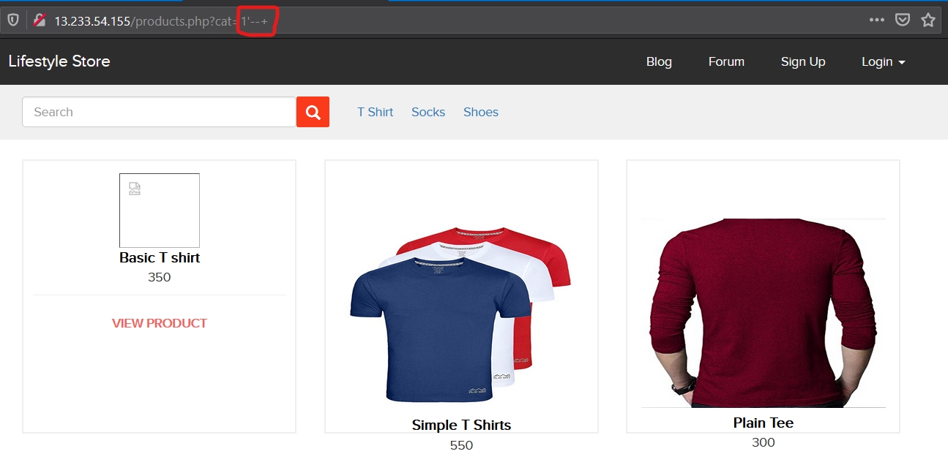
Observation
We then put --+ :products.php?cat=1’--+ and we error is removed confirming SQL injection.
Now hacker can inject sql or use sqlmap to get access to the database.

Slide 10
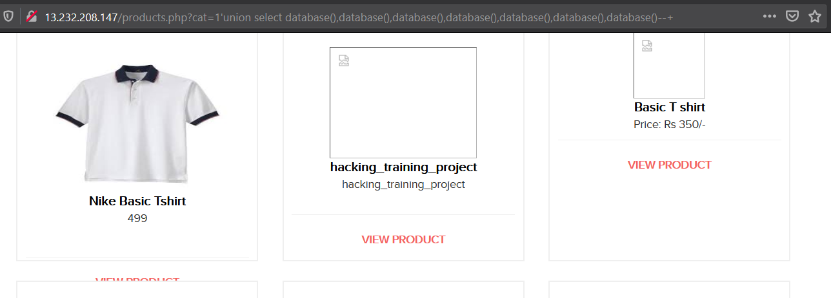
Proof of Concept (PoC)
Hacker can execute commands as shown below to get Critical Information, here we have used the below payload to find the name of the Database of MYSQL.

Slide 11
Proof of Concept(PoC)
No of Databases: 2
Information_schema
Hacking_training_project
No of Tables: 10
brands
cart_items
Categories
Customers
Order_items
Orders
Product_reviews
Products
Sellers
users

Slide 12
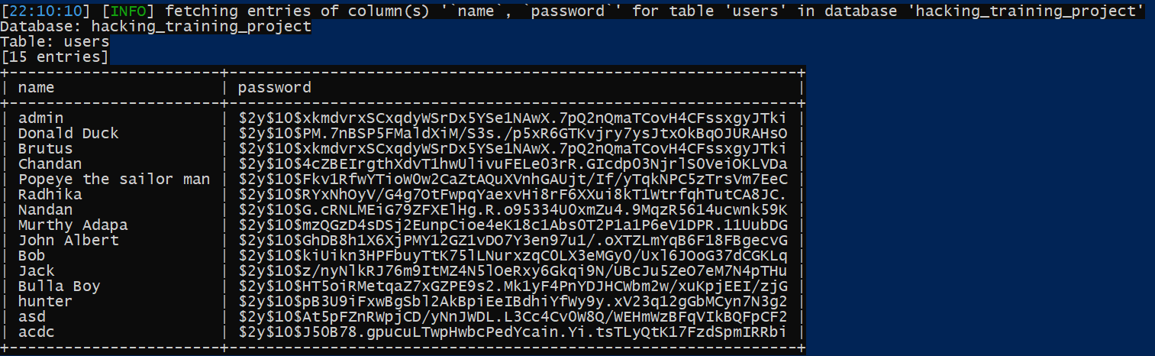
Business Impact – Extremely High
Using this vulnerability, attacker can execute arbitrary SQL commands on Lifestyle store server and gain complete access to internal databases along with all customer data inside it.
Below is the screenshot of users table which shows user credentials being leaked that too in plain text without any hashing/encryption.
Attacker can use this information to login to admin panels and gain complete admin level access to the website which could lead to complete compromise of the server and all other servers connected to it.

Slide 13
RECOMMENDATIONS
Take the following precautions to avoid exploitation of SQL injections:
Whitelist User Input: Whitelist all user input for expected data only.
Prepared Statements: Use SQL prepared statements available in all web development languages and frameworks to avoid attacker being able to modify SQL query
Character encoding: If you are taking input that requires you to accept special characters, encode it. Example. Convert all ‘ to \’ , “ to \”, \ to \\. It is also suggested to follow a standard encoding for all special characters such has HTML encoding, URL encoding etc.
Do not run Database Service as admin/root user
Disable/remove default accounts, passwords and databases
Assign each Database user only the required permissions and not all permissions

Slide 14
References
https://owasp.org/www-community/attacks/SQL_Injection
https://en.wikipedia.org/wiki/SQL_injection

Slide 15
2. Multiple Vulnerabilities in Blog
COMMON PASSWORD
Common Password (Severe) | Below mentioned URL has Weak and Very Common Password. Affected URL : http://52.66.35.61/wondercms/

Slide 16
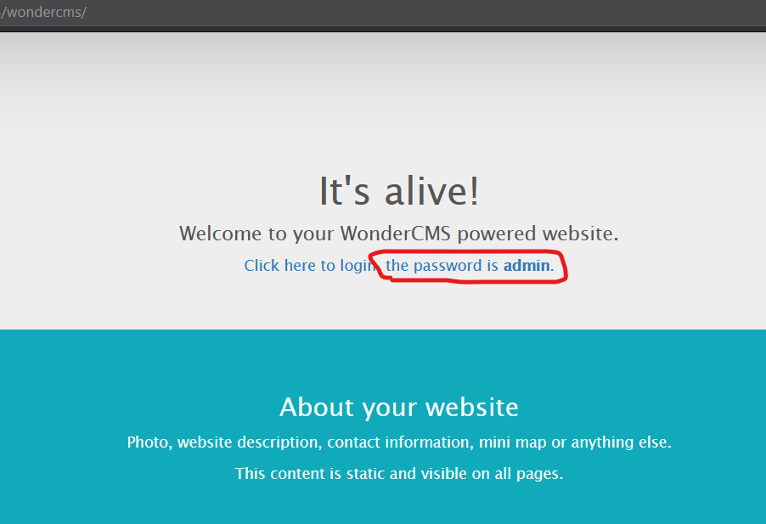
Observation
We get the password on the page.

Slide 17
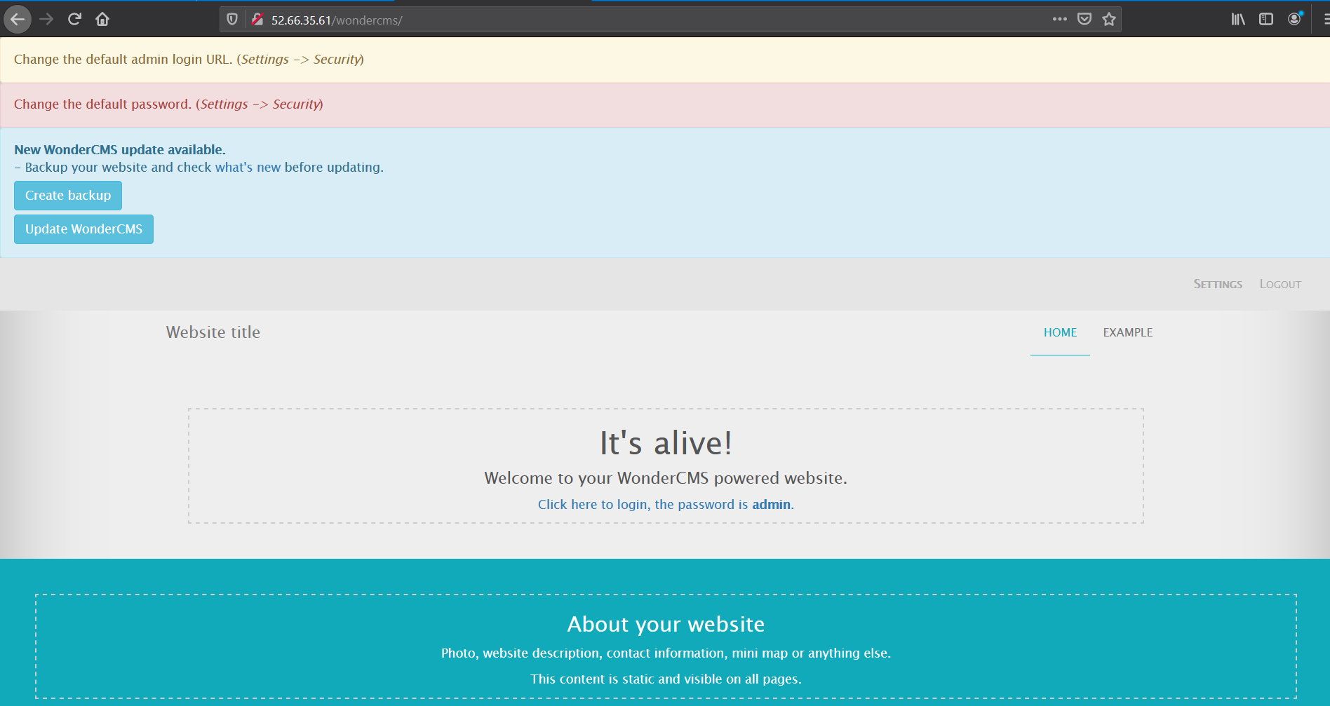
Observation
We successfully enter into the admin account.

Slide 18
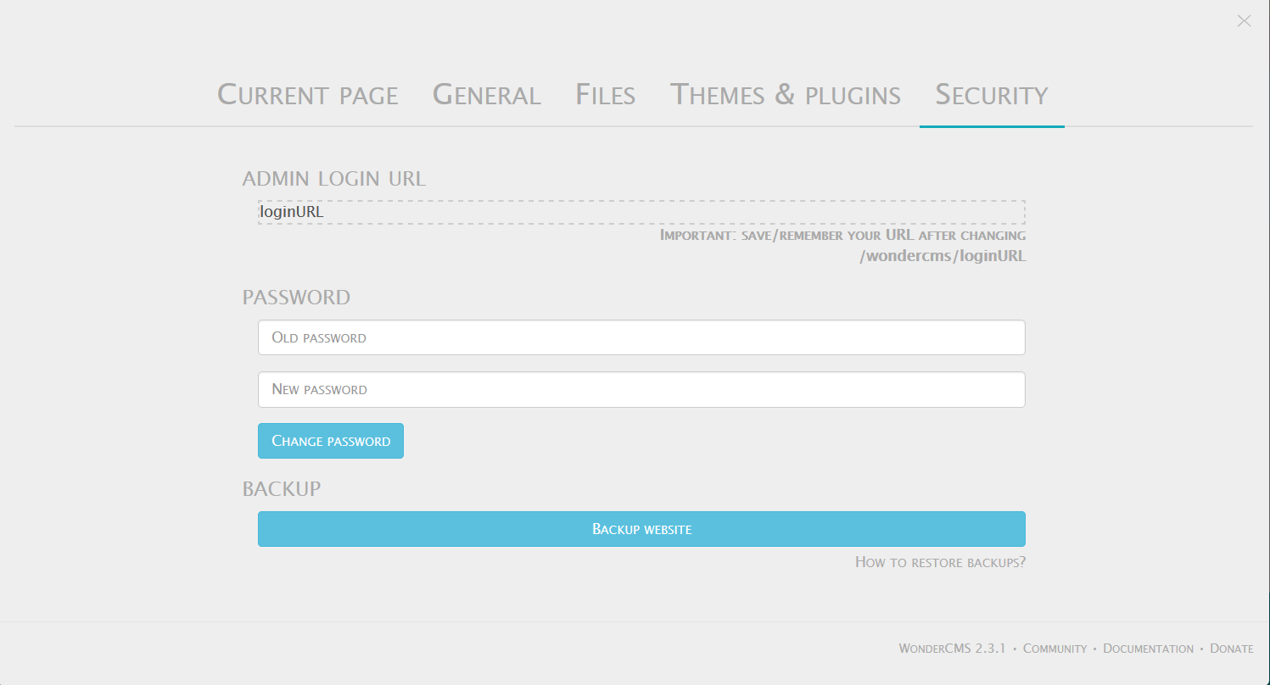
Business Impact – High
Easy, default and common passwords make it easy for attackers to gain access to their accounts illegal use of them and can harm the website to any extent after getting logged into privileged accounts.

Slide 19
Recommendation
There should be password strength check at every creation of an account.
There must be a minimum of 8 characters long password with a mixture of numbers, alphanumeric, special characters, etc.
There should be no repetition of password, neither on change nor reset.
The password should not be stored on the web, rather should be hashed and stored.

Slide 20
References
https://www.acunetix.com/blog/web-security-zone/common-password-vulnerabilities/
https://wiki.owasp.org/index.php/Testing_for_Weak_password_policy_(OTG-AUTHN-007)

Slide 21
b) Access to admin panel
Access to admin panel (Critical) | Below mentioned URL is vulnerable to Arbitrary File Upload and making other level changes. Affected URL : http://52.66.35.61/wondercms/loginURL

Slide 22
Arbitrary file upload (Critical) | The attacker can upload insecure shells and files and gain access over the entire database and login as the admin and the version is known to have vulnerabilities. Affected URL : http://52.66.35.61/wondercms/ http://52.66.35.61/wondercms/files/b374mini.php Affected Parameter : File Upload (POST Parameter) Affected URL : http://52.66.35.61/profile/2/edit/ Affected Parameter : Upload Profile Photo (POST Parameter) Affected URL : http://52.66.35.61/wondercms/files/minishell.php Affected Parameter : Shell Upload

Slide 23
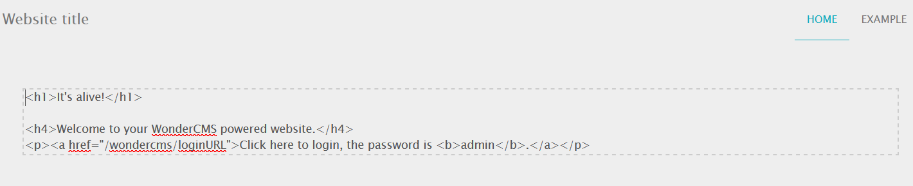
Observation
When we LOG-IN as ADMIN, First page of the site we can see some text written as IT’s Alive ! , if we click on it the HTML code start running and malicious hacker can easily make changes and can use the page as his/her Phishing Portal. This is a Classic example of Temporary XSS.

Slide 24
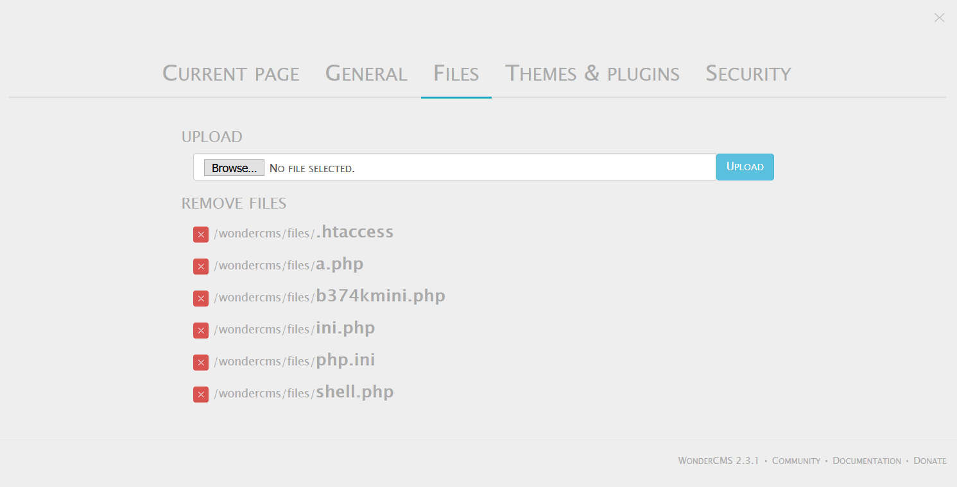
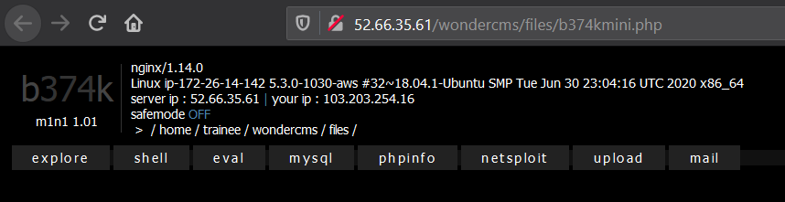
Observation
Inside ADMIN account got to settings option and go to “FILES” we can see some files with Extension “.php” which give information about the site and also very much capable of taking over the site. Select “b374kmini.php” option it will redirect us to a page which gives us many crucial information like severe IP address, Linux IP address, Server type, Database, Shell, Phpinfo which an be termed as Phishing.

Slide 25
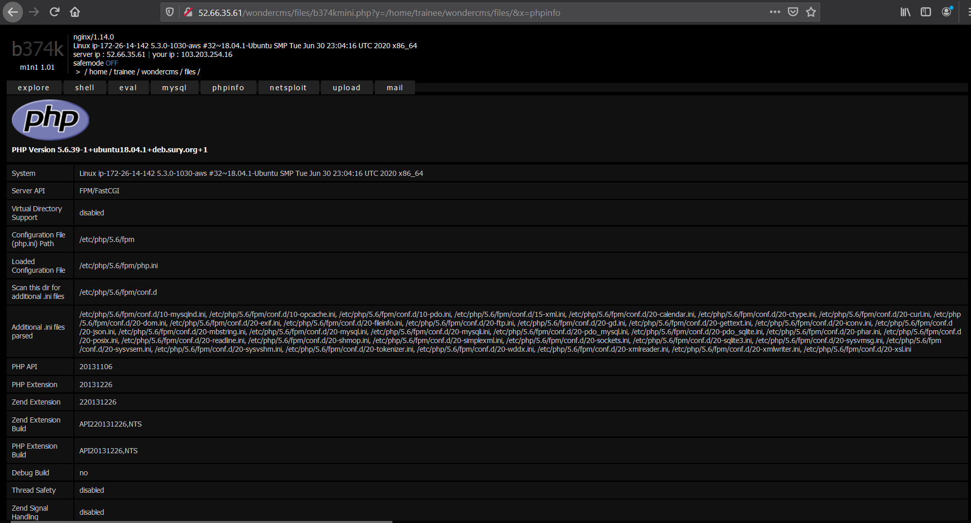
Observation

Slide 26
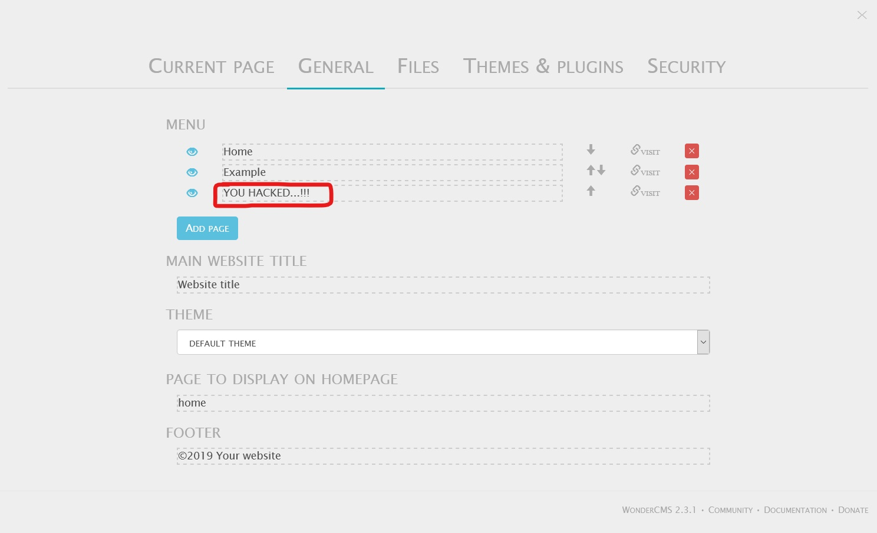
Observation
Inside ADMIN account if we go to settings -> general options, we can see that malicious hacker can injects and execute malicious client side scripts through it which gets permanently stored in the databases.

Slide 27
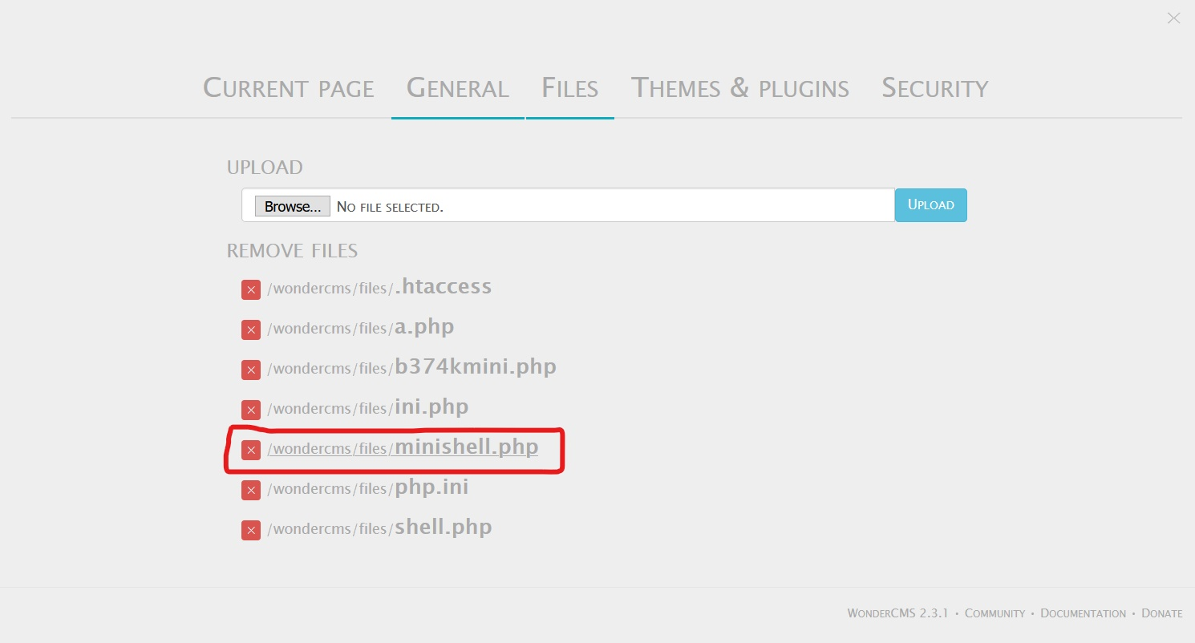
Observation
Inside ADMIN account go to settings -> files, we can find that files can be uploaded their with any file type extension one wants, now we upload the minishell into the site. It will give access to take over the whole website and will be a great breakage on the site.

Slide 28
Proof of Concept (PoC)
Weak password – admin
Arbitrary File Inclusion
Temporary XSS

Slide 29
Business Impact – Extremely High
A malicious hacker can access the Dashboard which disclose many critical information of organization including:
Important files
Password
Website info
And much more…

Slide 30
Business Impact – Extremely High
Any backdoor file or shell an be uploaded to get access to the uploaded file on remote server and data can be exfiltrated. The presence of an actual malicious file can compromise the entire system leading to system takeover/data stealing.

Slide 31
Recommendation
Change the Admin password to something strong and not guessable.
The application ode should be configured in such a way, that it should block uploading of malicious file extensions such as exe/php and other extensions with a thorough server as well as client validation. CVE ID allocated: CVE-2017-14521.
The website should have proper two factor authentication
Try to develop the back end more stronger and secure.
Remove all Directory listings and add proper sanitization techniques at checks of the website.

Slide 32
References
https://wiki.owasp.org/index.php/Unrestricted_File_Upload
https://www.opswat.com/blog/file-upload-protection-best-practices
https://cwe.mitre.org/data/definitions/548.html
https://www.w3schools.com/
https://www.wordfence.com/learn/how-to-prevent-file-upload-vulnerabilities/

Slide 33
3. Account Takeover Using OTP Bypass
Account Takeover using OTP Bypass (Critical) | Below mentioned login page allows login via OTP which can be bruteforced Affected URL : http://13.233.54.155/reset_password/admin.php?otp= Affected Parameters : OTP (POST parameter)

Slide 34
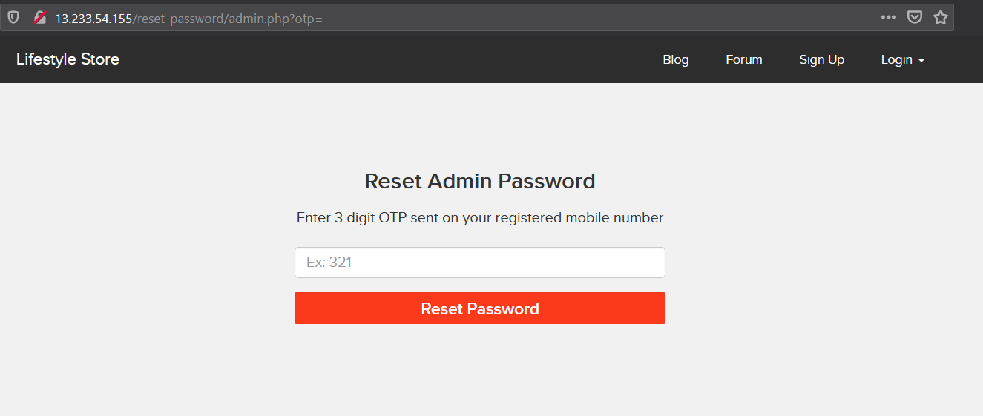
Observation
Navigate to http://13.233.54.155/reset_password/admin.php?otp= you will see user login page via OTP.

Slide 35
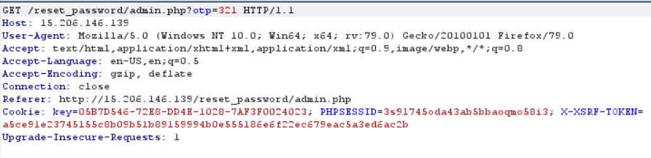
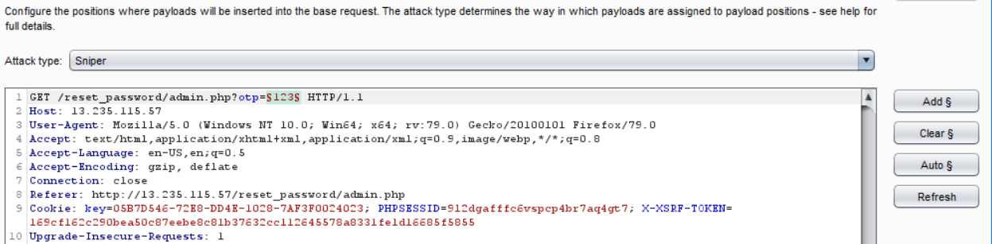
Observation
Following request will be generated containing OTP parameter.
Now we are bruteforcing it.

Slide 36
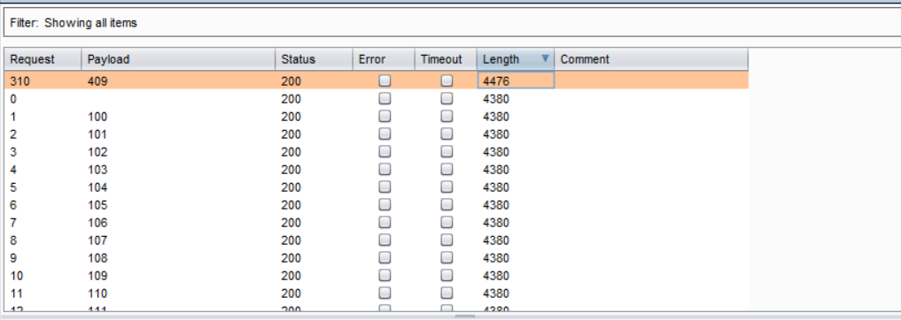
Observation
And we easily got the valid OTP

Slide 37
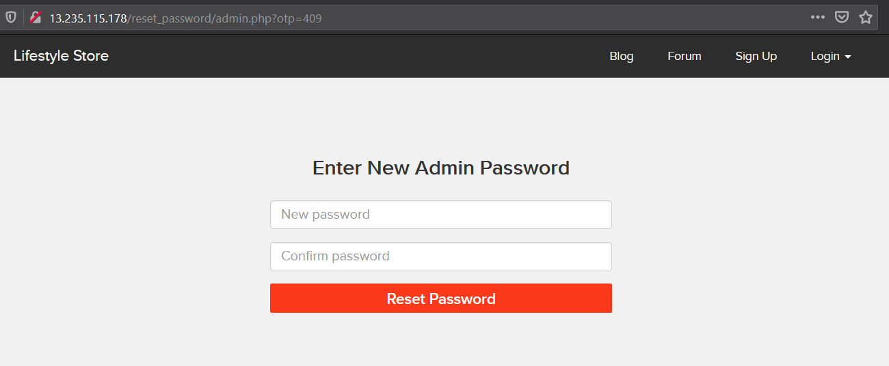
Proof of Concept (PoC)
Now a hacker can change the password of admin dashboard.

Slide 38
Business Impact – Extremely High
A malicious hacker can gain complete access to any account just by brute forcing the OTP. This leads to complete compromise of personal user data of every customer.
Attacker once logs in can then carry out actions on behalf of the victim which could lead to serious financial loss to him/her.

Slide 39
Recommendation
Take the following precautions:
Use proper rate-limiting checks on the no of OTP checking and generation requests.
Implement anti-bot measures such as ReCAPTCHA after multiple incorrect attempts.
OTP should expire after certain amount of time like 2 minutes.
OTP should be at least 6 digit and alphanumeric for more security.

Slide 40
References
https://wiki.owasp.org/index.php/Testing_Multiple_Factors_Authentication_(OWASP-AT-009)
https://wiki.owasp.org/index.php/Blocking_Brute_Force_Attacks
https://www.kaspersky.com/resource-center/definitions/brute-force-attack
https://en.wikipedia.org/wiki/Rate_limiting

Slide 41
4. Default Messages
Default messages (Low) | Below mentioned URL, if add a specific payload it will show default messages. Affected URL : http://13.233.54.155/?includelang=lang/en.php Payload: en.php’ (GET Parameter)

Slide 42
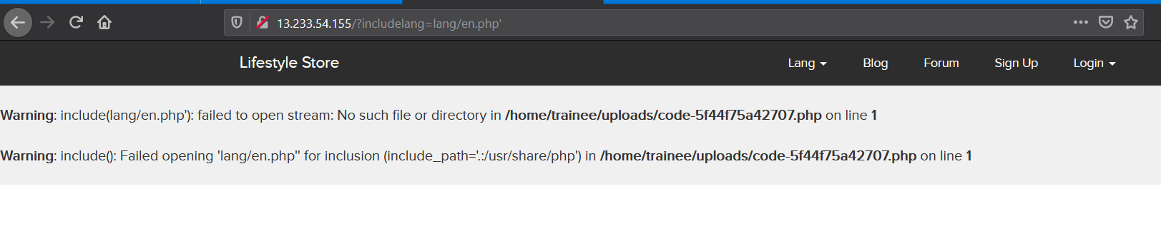
Observation & PoC
Here we added payload as shown above and we got an error.

Slide 43
Business Impact - Moderate
Although this vulnerability does not have a direct impact to users or the server, though it can help the attacker in mapping the server architecture and plan further attacks on the server.

Slide 44
Recommendations
Do not display the default error messages because it not tells about the server but also sometimes about the locations. So, whenever there is an error, send it to the same page or throw some manually written error.
References:
https://wiki.owasp.org/index.php/Improper_Error_Handling

Slide 45
5. Open Redirection
Open Redirection (Low) | Below mentioned URLs we can change the path of redirection Affected URL : http://13.233.54.155/?includelang=lang/en.php http://13.233.54.155/?includelang=lang/fr.php Affected Parameters : ?inludinglang= (POST parameter) Payload: http://13.233.54.155/?includelang=google.com?lang/en.php

Slide 46
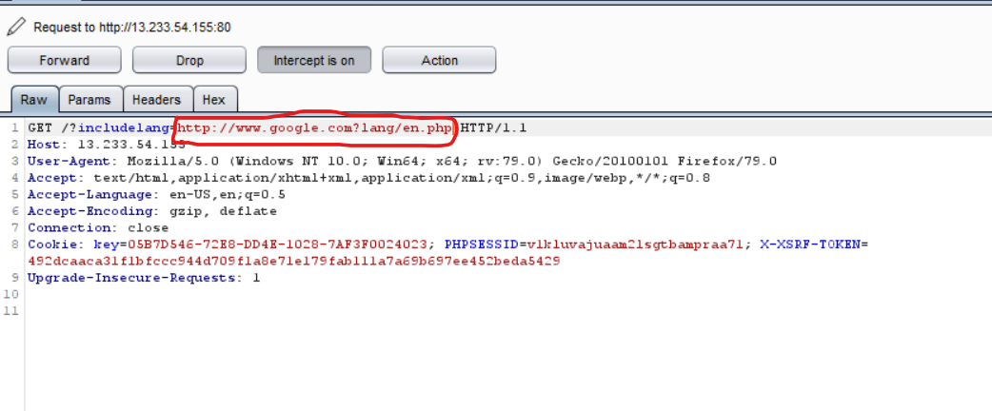
Observation
Here we made changes to the URL according to the payload.

Slide 47
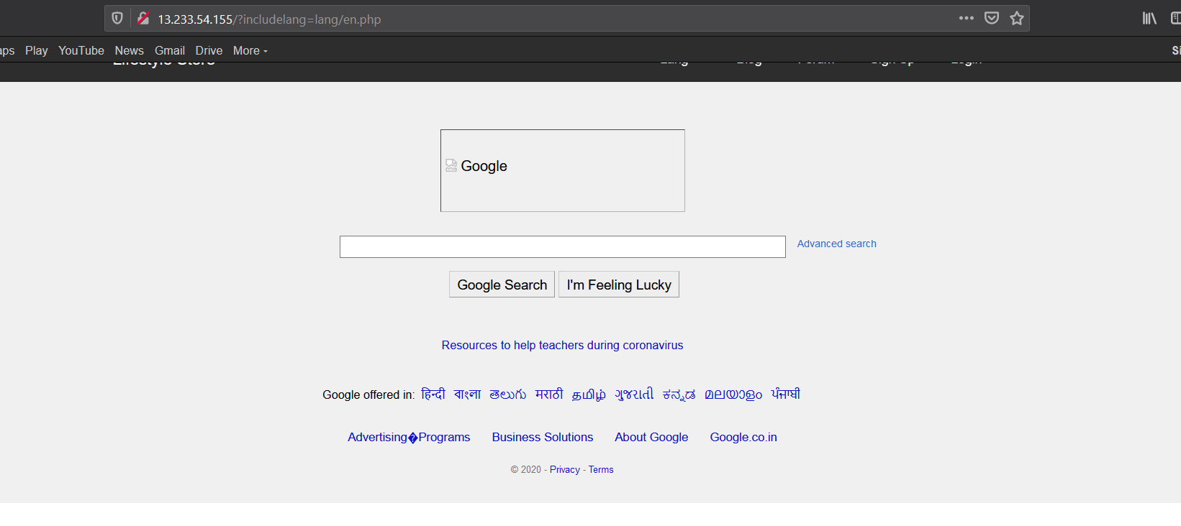
Proof of Concept (PoC)
We are redirected to google.

Slide 48
Business Impact - Low
The http parameter may contain a URL value and could cause the web application to redirect the request to the specified URL. By modifying the URL value to a malicious site.

Slide 49
Recommendations
Disallow Offsite Redirects.
If you have to redirect the user based on URLs, instead of using untrusted input you should always use an ID which is internally resolved to the respective URL.
If you want the user to be able to issue redirects you should use a redirection page that requires the user to click on the link instead of just redirecting them.
You should also check that the URL begins with http:// or https:// and also invalidate all other URLs to prevent the use of malicious URLs such as JavaScript.

Slide 50
References
https://cwe.mitre.org/data/definitions/601.html
https://www.netsparker.com/blog/web-security/open-redirection-vulnerability-information-prevention/#:~:text=What%20Is%20the%20Impact%20of,cases%20even%20cause%20XSS%20attacks.
https://blog.detectify.com/2019/05/16/the-real-impact-of-an-open-redirect/

Slide 51
6. CSRF
Unauthorized Access to Customer Details (Critical) | Below mentioned login page allow you to change password without verification and view details of the other customers (CSRF). Affected URL : http://13.233.54.155/profile/change_password.php Affected Parameters : Update button (POST parameter) we can change the password. Affected URL : http://13.233.54.155/cart/cart.php Affected Parameters : Remove option (POST parameter) Affected URL : http://13.233.54.155/cart/cart.php Affected Parameters : Confirm order option (POST parameter)

Slide 52
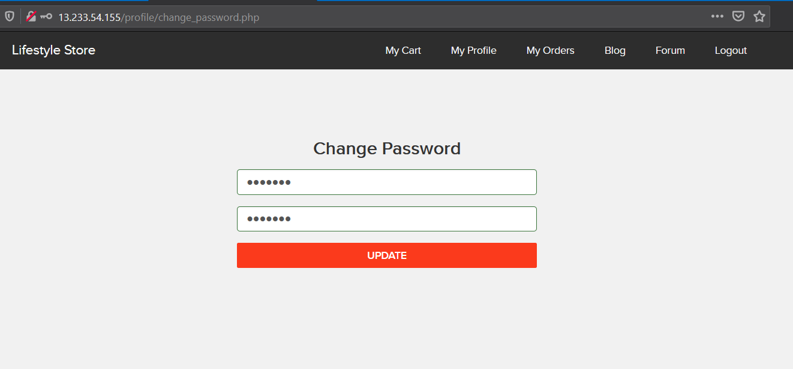
Observation
Here you can see 7 digit password, but due to CSRF I’ll change the password at the moment he wan to update.

Slide 53
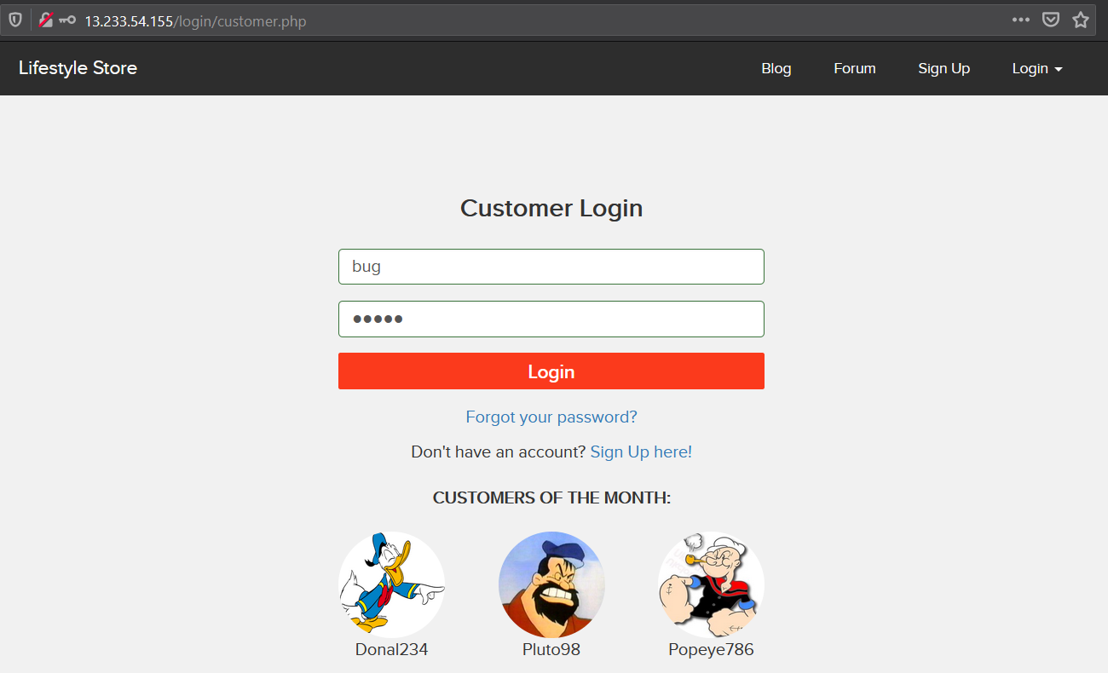
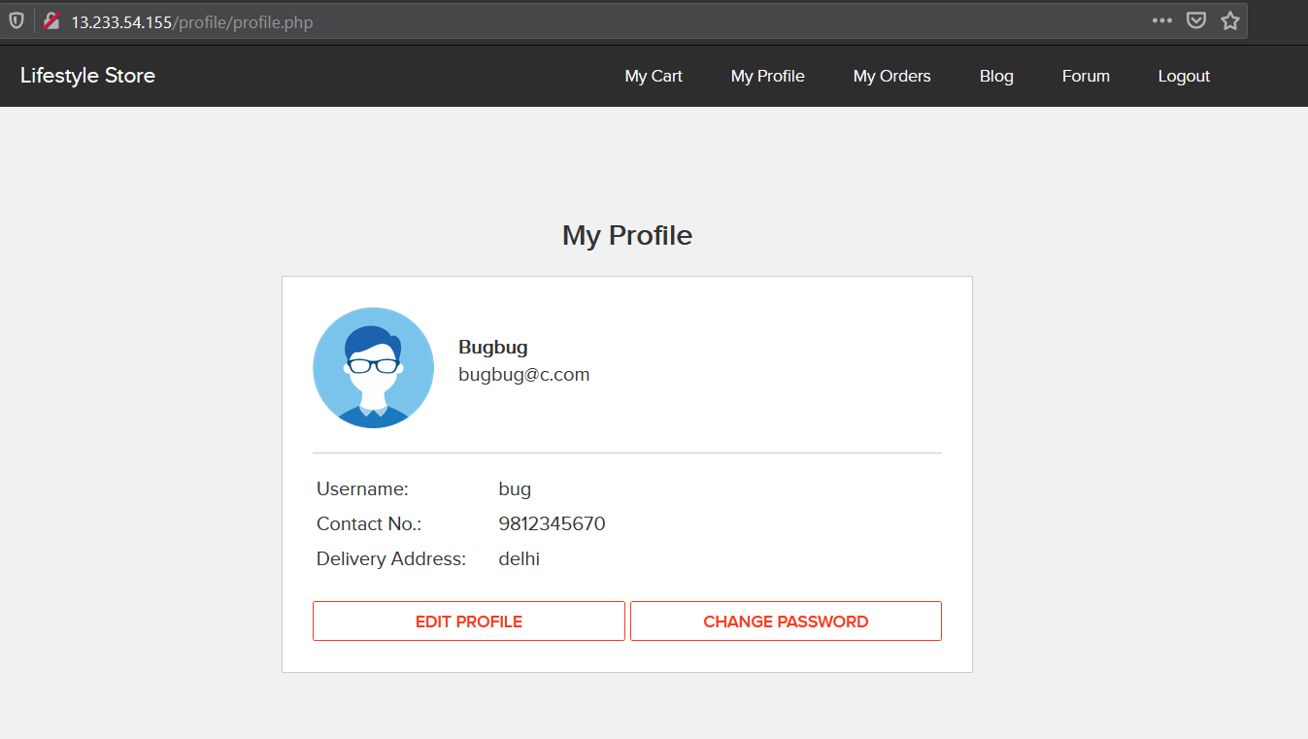
Observation
Using burp suite we can tamper the request and handle the CSRF token.

Slide 54
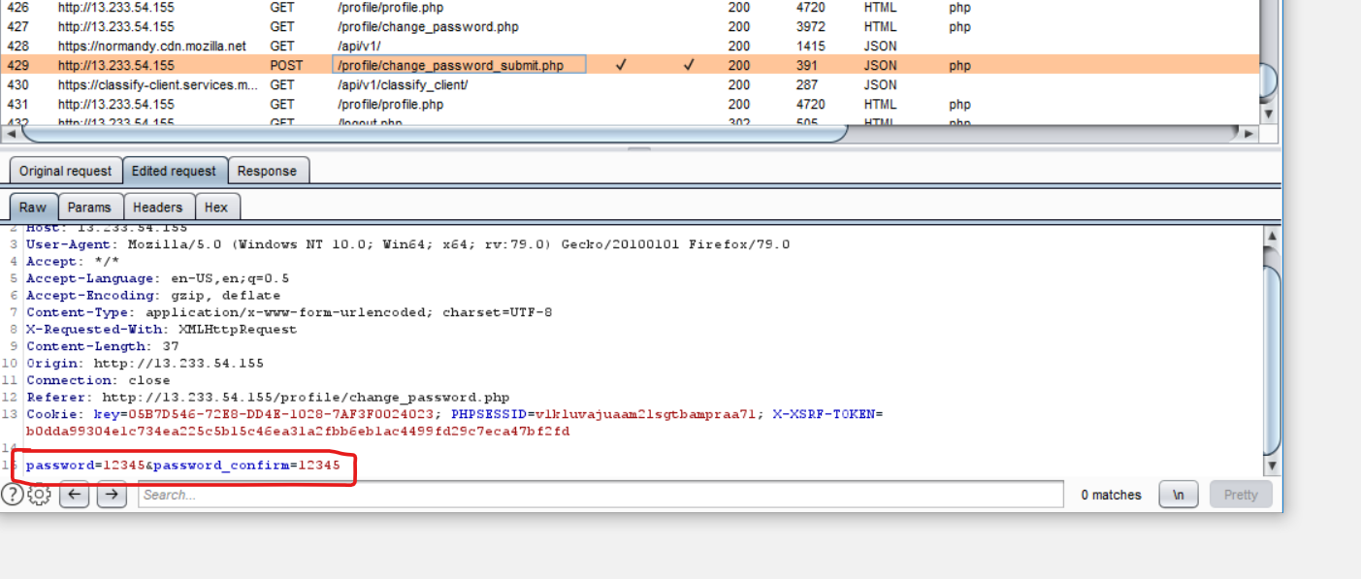
Proof of concept (Poc)
Here’s the code editing in burp suite community edition.

Slide 55
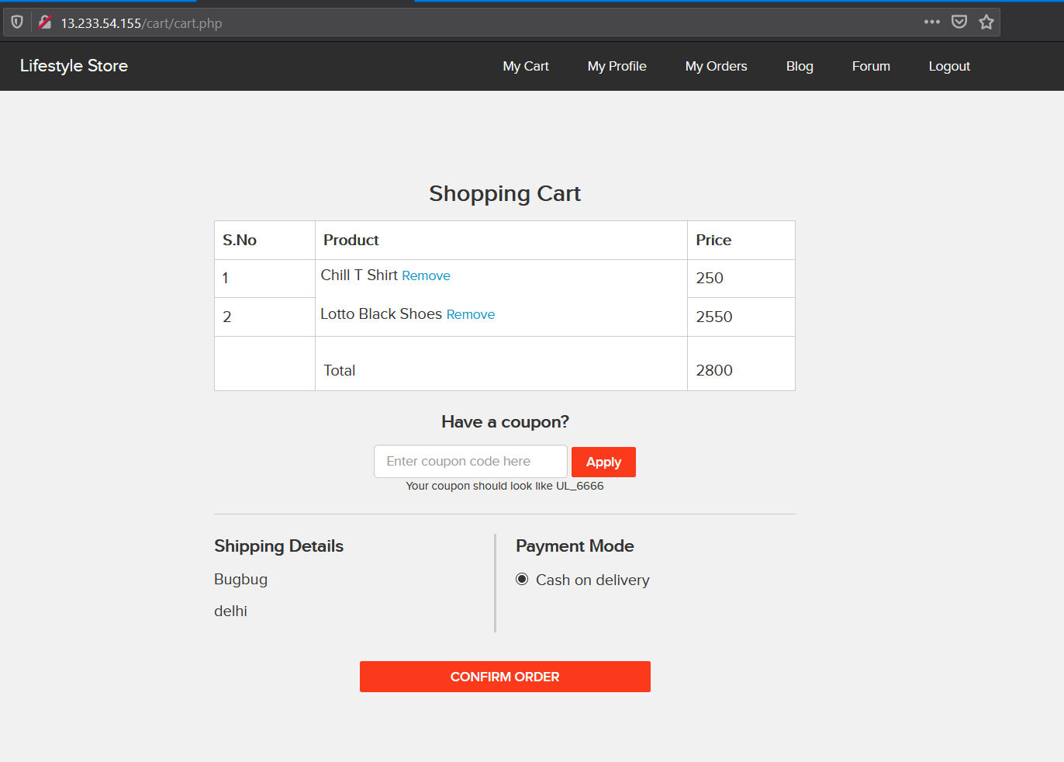
Observation
CSRF in Cart.

Slide 56
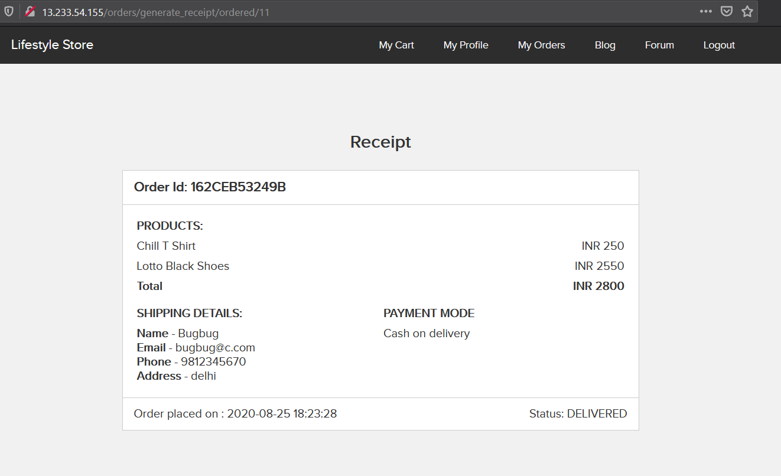
Observation
Here you can see order is placed unwantedly by user.

Slide 57
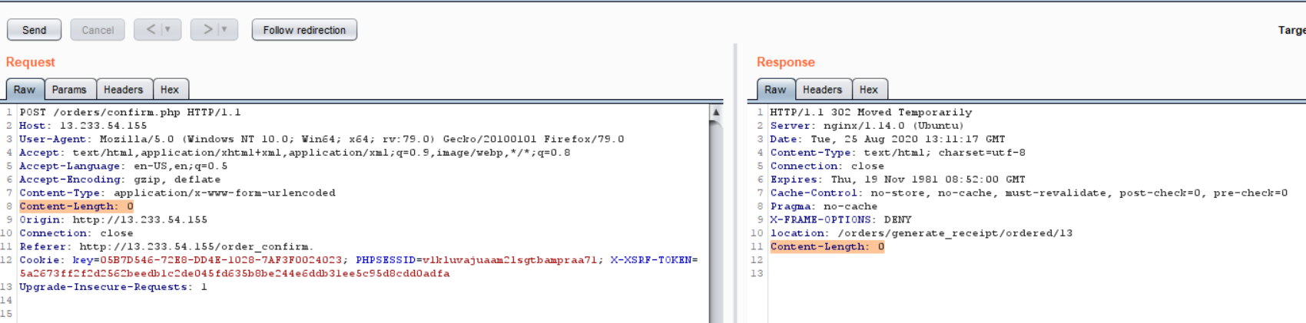
Proof of Concept (PoC)
Here request tamper in the burp suite.

Slide 58
Business Impact – Very High
Hacker can change the password of any user.
Hacker can make user to do unwanted things.
It makes very bad impact of the website in the front of user.
Hacker an remove and confirm orders in the cart of the use.

Slide 59
Recommendation
Take the following precautions:
Implement an Anti-CSRF token.
Do not show the customers of the month on the login page.
Use the same site flag in cookies.
Check the source of request made.
Take some extra keys or tokens from the user before processing an important request.
Use 2 factor confirmations like opt, etc. for critical requests.

Slide 60
References
https://wiki.owasp.org/index.php/Cross-Site_Request_Forgery_(CSRF)
https://en.wikipedia.org/wiki/Cross-site_request_forgery
https://www.netsparker.com/blog/web-security/csrf-cross-site-request-forgery/
https://cwe.mitre.org/data/definitions/352.html

Slide 61
7. Reflected Cross Site Scripting (XSS)
Reflected Cross Site Scripting (Severe) | Below mentioned parameters are vulnerable to reflected XSS Affected URL : http://13.233.54.155/profile/16/edit/ Affected Parameters : address (POST parameter) Payload: <script>alert(1)</script>

Slide 62
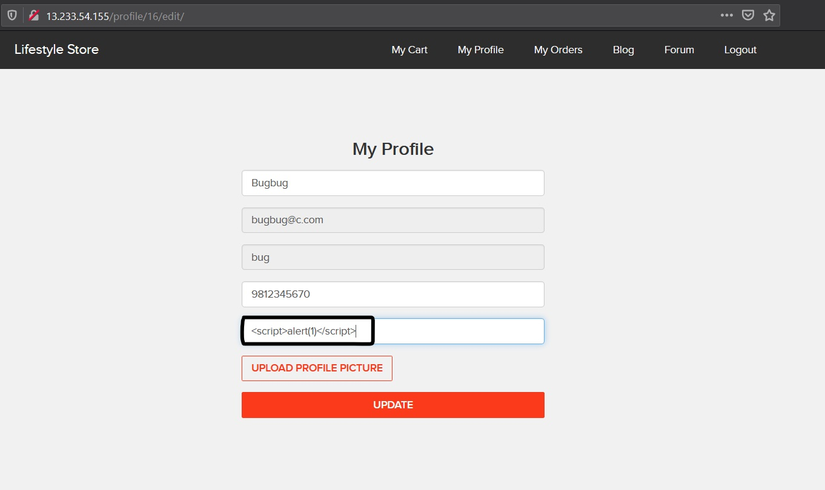
Observation
Open edit profile through URL and write a script on address bar.

Slide 63
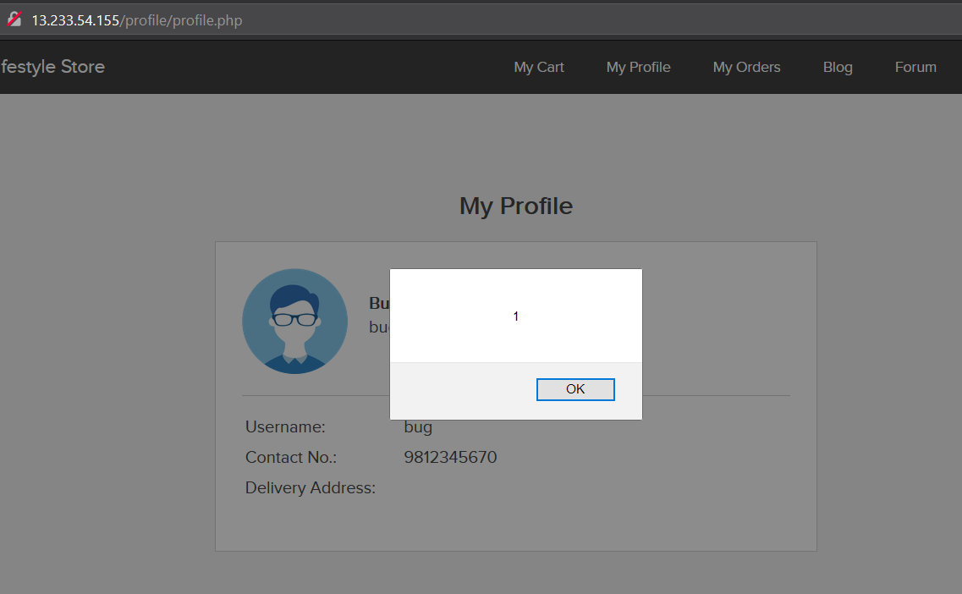
Proof of Concept (PoC)

Slide 64
Business Impact - High
As attacker can inject arbitrary HTML CSS and JS via the URL, attacker can put any content on the page like phishing pages, install malware on victim’s device and even host explicit content that could compromise the reputation of the organization.
All attacker needs to do is send the link with the payload to the victim and victim would see hacker controlled content on the website. As the user trusts the website, he/she will trust the content.

Slide 65
Recommendation
Take the following precautions:
Sanitize all user input and block characters you do not want.
Convert special HTML characters like ‘ “ <> [] into HTML entities & quot; %22 & lt; &gt; before printing them on the website.

Slide 66
References
https://wiki.owasp.org/index.php/Cross-site_Scripting_(XSS)
https://en.wikipedia.org/wiki/Cross-site_scripting
https://owasp.org/www-project-top-ten/OWASP_Top_Ten_2017/Top_10-2017_A7-Cross-Site_Scripting_(XSS)
https://medium.com/faun/the-impact-of-cross-site-scripting-vulnerabilities-and-their-prevention-8ae6376ddbca

Slide 67
8. Stored Cross Site Scripting (XSS)
SQL Injection (Critical) | Below mentioned parameters are vulnerable to reflected XSS Affected URL : http://13.233.54.155/products/details.php?p_id=16 Affected Parameters : Post button under customer review (POST parameter) Payload: <script>alert(“Hacked”)</script> <h1>hello</h1>

Slide 68
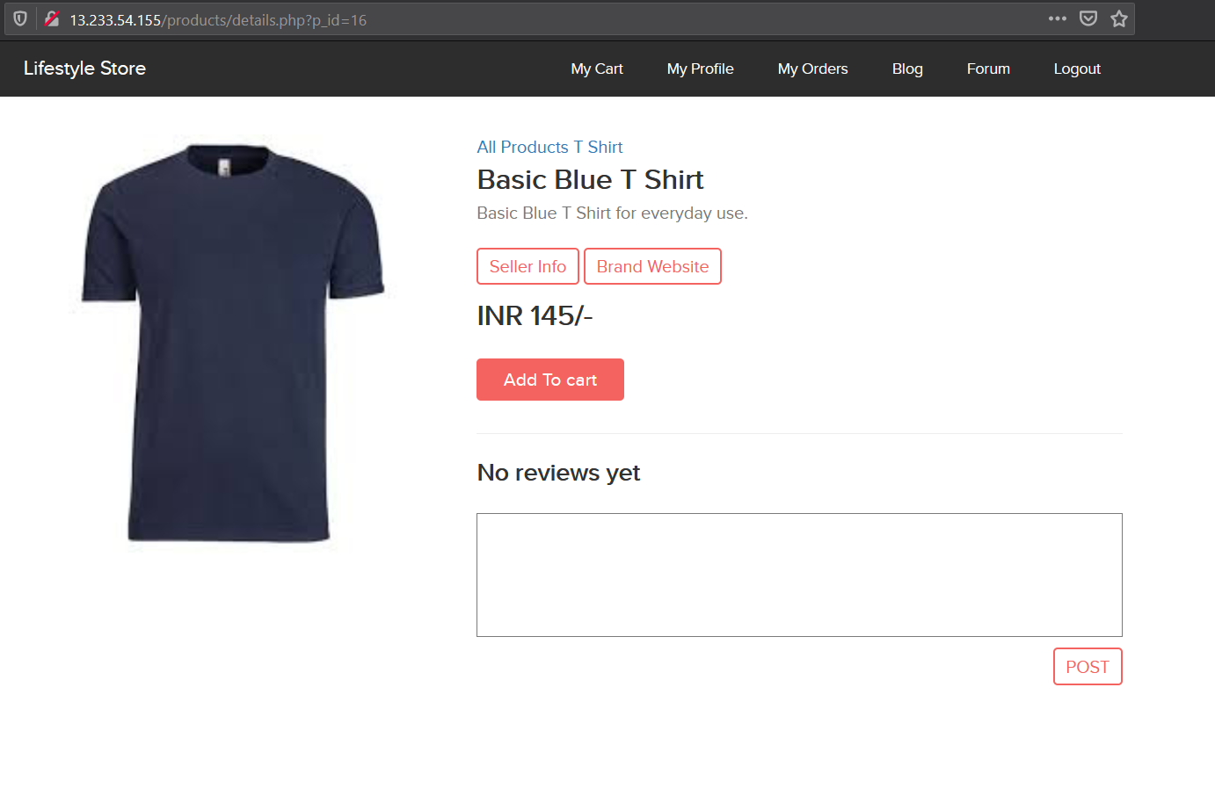
Observation
Now try entering the payload in review box.

Slide 69
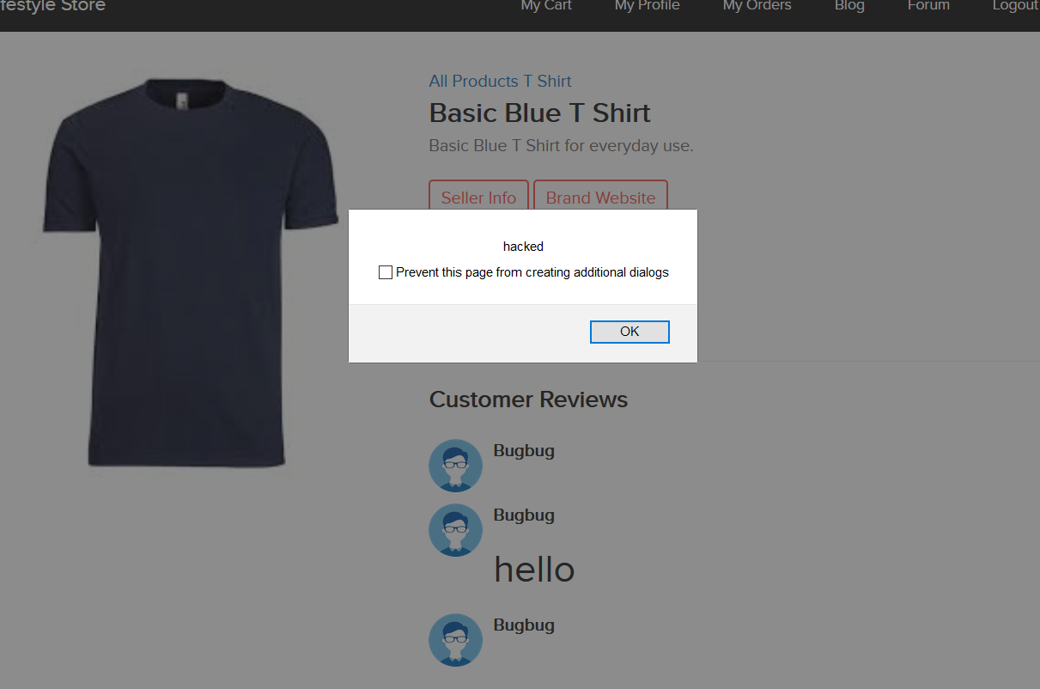
Observation
Hit post button , you can see stored XSS or Permanent XSS

Slide 70
Business Impact - High
As attacker can inject arbitrary HTML CSS and JS via the URL, attacker can put any content on the page like phishing pages, install malware on victim’s device and even host explicit content that could compromise the reputation of the organization.
All attacker needs to do is send the link with the payload to the victim and victim would see hacker controlled content on the website. As the user trusts the website, he/she will trust the content.

Slide 71
Recommendation
Take the following precautions:
Sanitize all user input and block characters you do not want.
Convert special HTML characters like ‘ “ <> [] into HTML entities & quot; %22 & lt; &gt; before printing them on the website.

Slide 72
References
https://wiki.owasp.org/index.php/Cross-site_Scripting_(XSS)
https://en.wikipedia.org/wiki/Cross-site_scripting
https://owasp.org/www-project-top-ten/OWASP_Top_Ten_2017/Top_10-2017_A7-Cross-Site_Scripting_(XSS)
https://medium.com/faun/the-impact-of-cross-site-scripting-vulnerabilities-and-their-prevention-8ae6376ddbca

Slide 73
9. Component with known vulnerability
Component with known vulnerability (Severe) | Server used is nginx/1.14.0 appears to be outdated (current is at least 1.17.3) i.e it is known to have exploitable vulnerabilities. WonderCMS Codoforum (Powered by codologic)

Slide 74
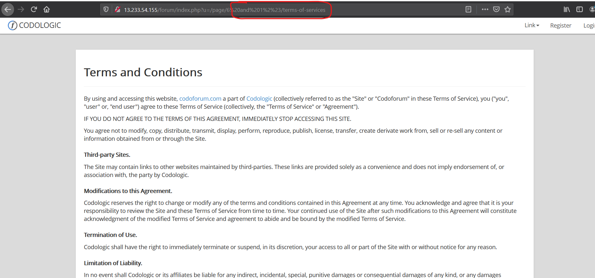
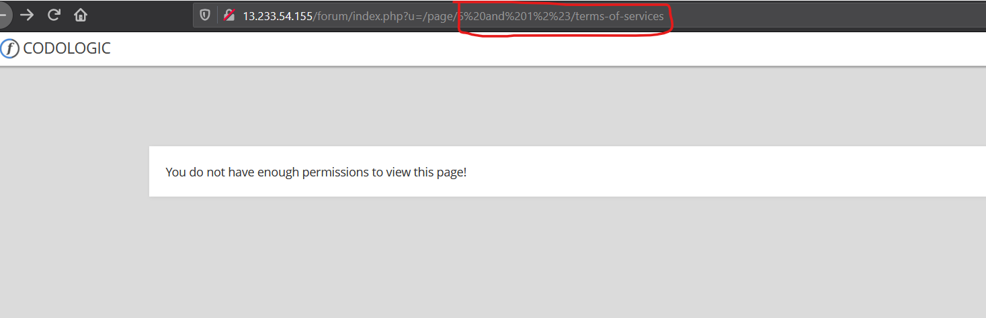
Observation
Codologic Vulnerability:- Now you can see that they have blind sql injection vulnerability.

Slide 75
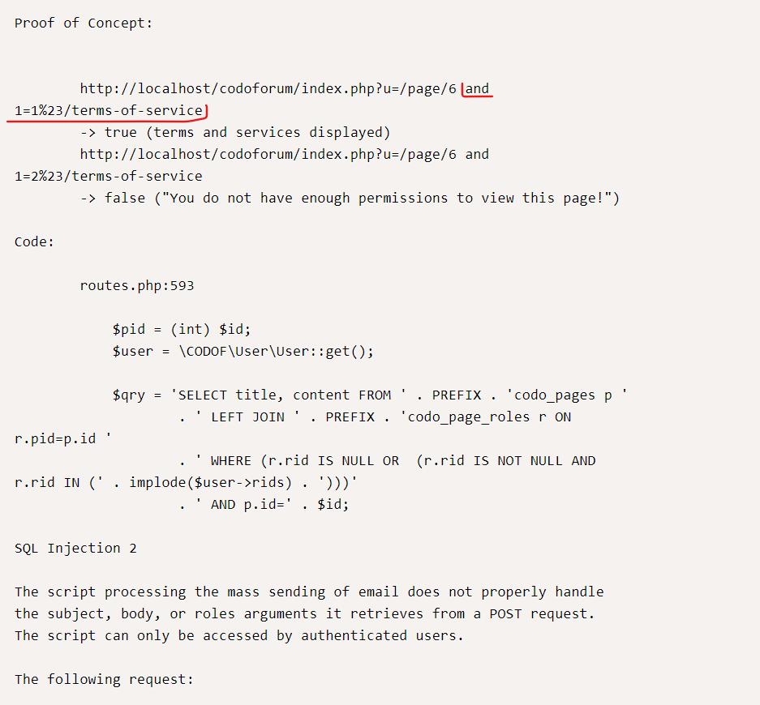
Proof of concept (PoC)
Codologic Vulnerability,
It has multiple sql injection vulnerability,
check the link of exploit-db in reference.

Slide 76
Business Impact - High
Exploits of every vulnerability detected is regularly made public and hence outdated software can very easily be taken advantage of. If the attacker comes o know about this vulnerability, he may directly use the exploit to take down the entire system, which is a big risk.

Slide 77
Recommendation
Upgrade to the latest version of affected software /theme /plugin/OS which means latest version.
If upgrade is not possible for the time being , isolated the server from any other critical data and servers.

Slide 78
References
https://ubuntu.com/security/notices/USN-4099-1
https://ubuntu.com/security/notices/USN-4099-1

Slide 79
10. Server Misconfiguration
Server misconfiguration (Moderate) | Below mentioned URL will show you the server related info. Affected URL : http://52.66.35.61/server-status http://52.66.35.61/server-info

Slide 80
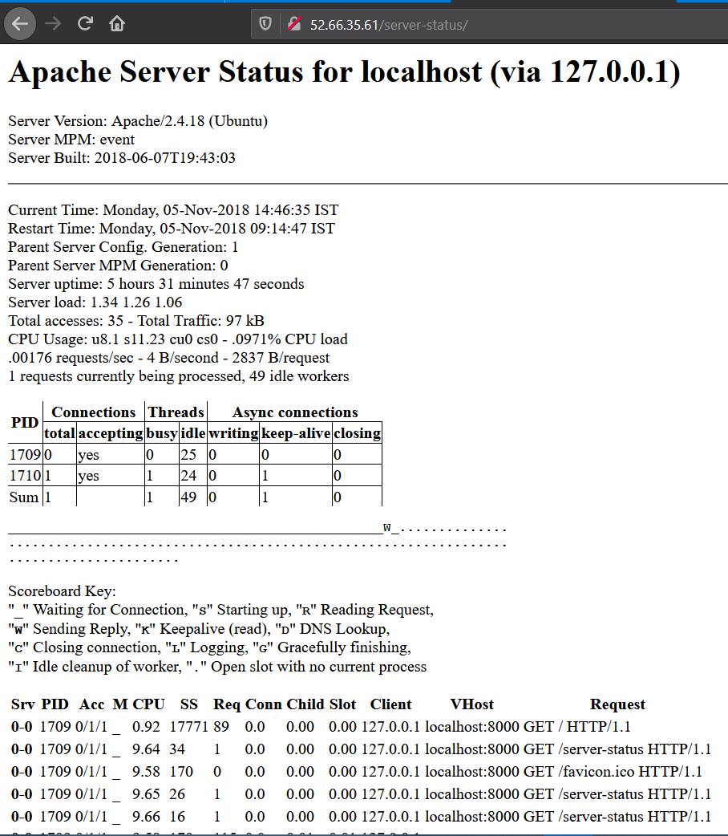
Observation and Poc

Slide 81
Recommendation
Keep the software up to date.
Disable all the default accounts and change passwords regularly.
Develop strong app architecture and encrypt data which has sensitive information.
Make sure that the security settings in the framework and libraries are set to secured values.
Perform regular audits and run tools to identify the holes in the system.

Slide 82
References
https://owasp.org/www-project-top-ten/OWASP_Top_Ten_2017/Top_10-2017_A6-Security_Misconfiguration#:~:text=Such%20flaws%20frequently%20give%20attackers,of%20the%20application%20and%20data.
https://www.indusface.com/blog/owasp-security-misconfiguration/
https://www.tutorialspoint.com/security_testing/testing_security_misconfiguration.htm
https://blog.detectify.com/2016/06/17/owasp-top-10-security-misconfiguration-5/

Slide 83
11. Unauthorized access to user details (IDOR)
Unauthorized access to user details (Moderate) | Below mentioned URL will have the vulnerability through which anyone can see the details of another user Affected URL : http://13.233.54.155/orders/generate_receipt/ordered/14 Affected Parameters : Ordered/14 (GET parameter) Payload: http://13.233.54.155/orders/generate_receipt/ordered/13

Slide 84
Unauthorized access to user details (Moderate) | Below mentioned URL will have the vulnerability through which anyone can see the details of another user You just have to change the numeric value given in the URL’s. They can be seen as customer id. Affected URL : http://13.233.54.155/orders/orders.php?customer=13 http://13.233.54.155/orders/orders.php?customer=16 http://13.233.54.155/profile/16/edit/ http://13.233.54.155/forum/index.php?u=/user/profile/4

Slide 85
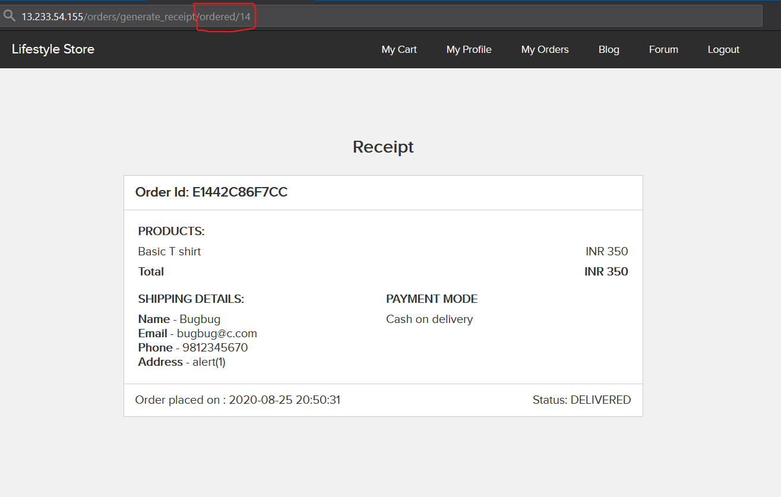
Observation
When we change the payload we can see the receipts of other users or customers.

Slide 86
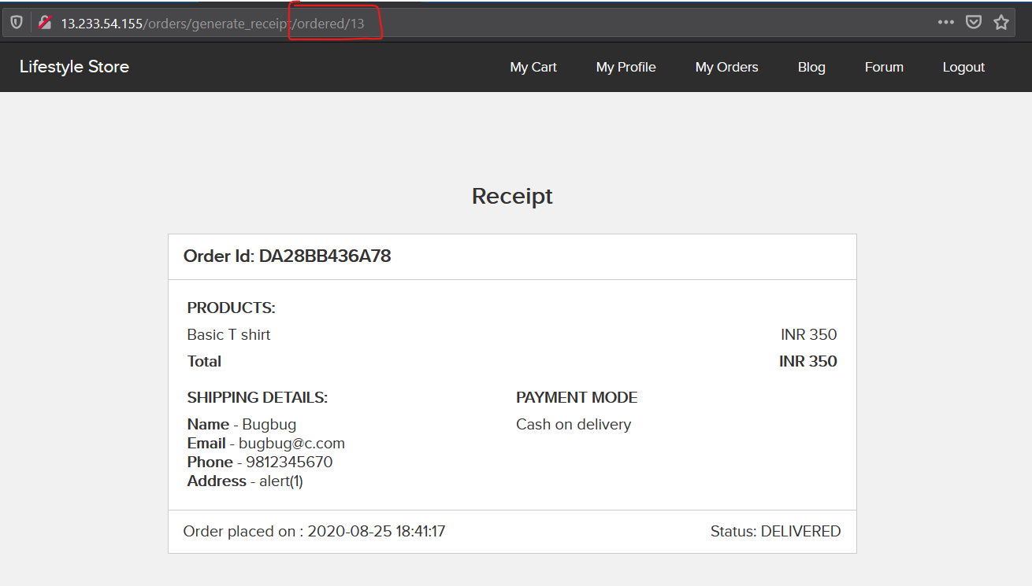
Proof of Concept (PoC)
Here you can clearly see the receipt of another user.

Slide 87
Business Impact – Extremely High
A malicious hacker can read bill information and account details of any user just by knowing the customer id and user id. This discloses critical billing information of users including:
Mobile Number
Bill Number
Billing Period
Total number of orders ordered by customer
Bill amount and breakdown
Phone no. and email address
Address
This can be used by malicious hackers to carry out targeted phishing attacks on the users and the information can also be sold to competitors/black-market. Moreover, as there is no rate limiting checks, attacker can brute force the user_id for all possible values and get bill information of each and every user of the organization resulting is a massive information leakage.

Slide 88
Recommendation
Take the following precautions:
Implement proper authentication and authorisation checks to make sure that the user has permission to the data he/she is requesting.
Use proper rate limiting checks on the number of request comes from a single user in a small amount of time.
Make sure each user can only see his/her data only.

Slide 89
References
https://wiki.owasp.org/index.php/Insecure_Configuration_Management
https://blog.securelayer7.net/owasp-top-10-4-insecure-direct-object-reference-vulnerability/

Slide 90
12. Directory Listings
Directory listings (Moderate) | Below mentioned URLs disclose server information. Affected URL : http://13.233.54.155/phpinfo.php http://13.233.54.155/robots.txt http://13.233.54.155/composer.lock http://13.233.54.155/composer.json http://13.233.54.155/userlist.txt

Slide 91
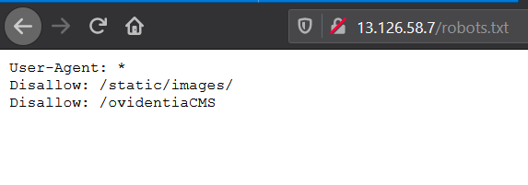
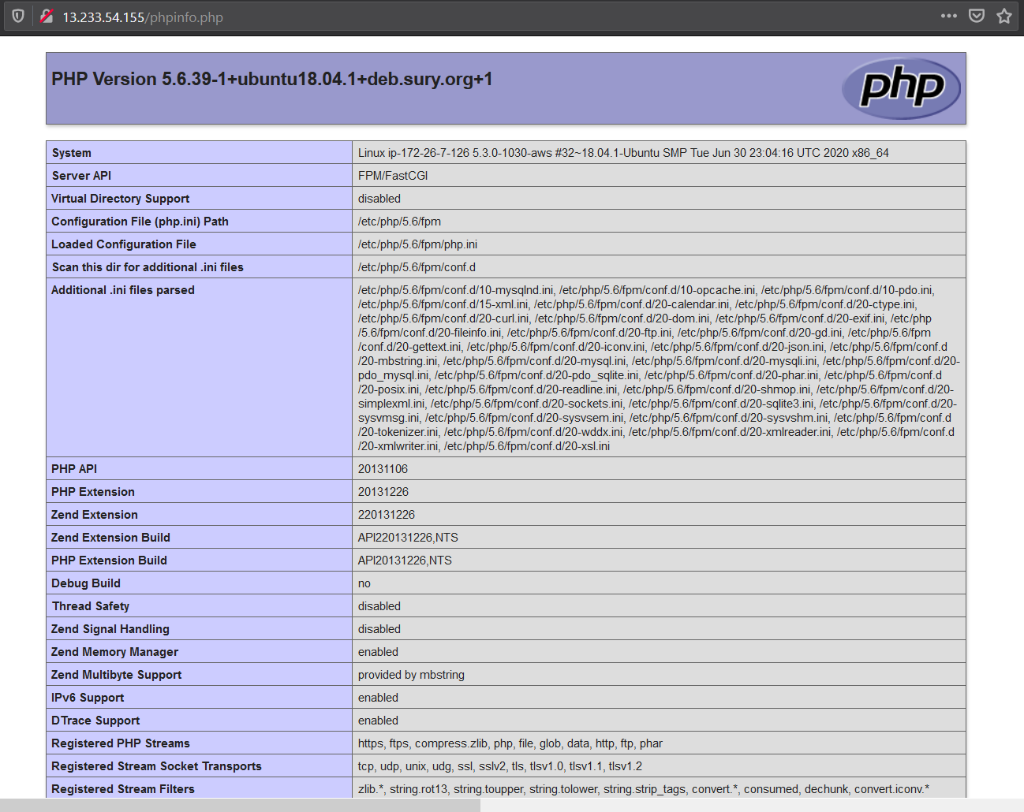
Observation

Slide 92
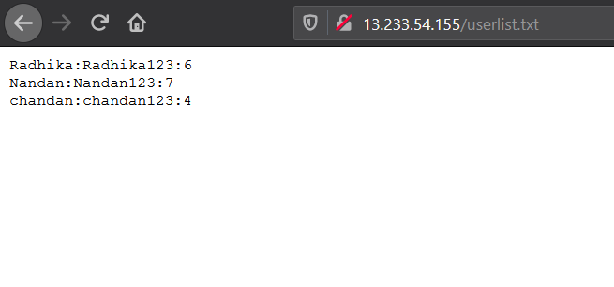
Proof of Concept (PoC)
In above observation you can see that a hacker can go through these directory easily and gather as much as information he/she want.
In fact it also shows some accounts of seller.

Slide 93
Business Impact - Moderate
Although this vulnerability does not have a direct impact to users or the server, through it can be aid the attacker with information about the server and the users. Information Disclosure due to default pages are not exploitable in most cases, but are considered as web application security issues because they allows malicious hackers to gather relevant information which can be used later in the attack lifecycle, in order to achieve more than they could if they didn’t get access to such information.

Slide 94
Recommendation
Disable all default pages.
Enable multiple security checks

Slide 95
References
https://www.netsparker.com/blog/web-security/information-disclosure-issues-attacks/
https://www.ibm.com/support/knowledgecenter/SSB2MG_4.6.0/com.ibm.ips.doc/concepts/wap_information_disclosure.htm
https://www.sciencedirect.com/topics/computer-science/information-disclosure

Slide 96
13. Personal Information Leakage
Personal Information Leakage (Low) | Below mentioned URLs disclose personal information Affected URL : http://13.233.54.155/static/images/ http://13.233.54.155/static/images/customers/ http://13.233.54.155/static/images/customers/default.png http://13.233.54.155/products/details.php?p_id=2

Slide 97
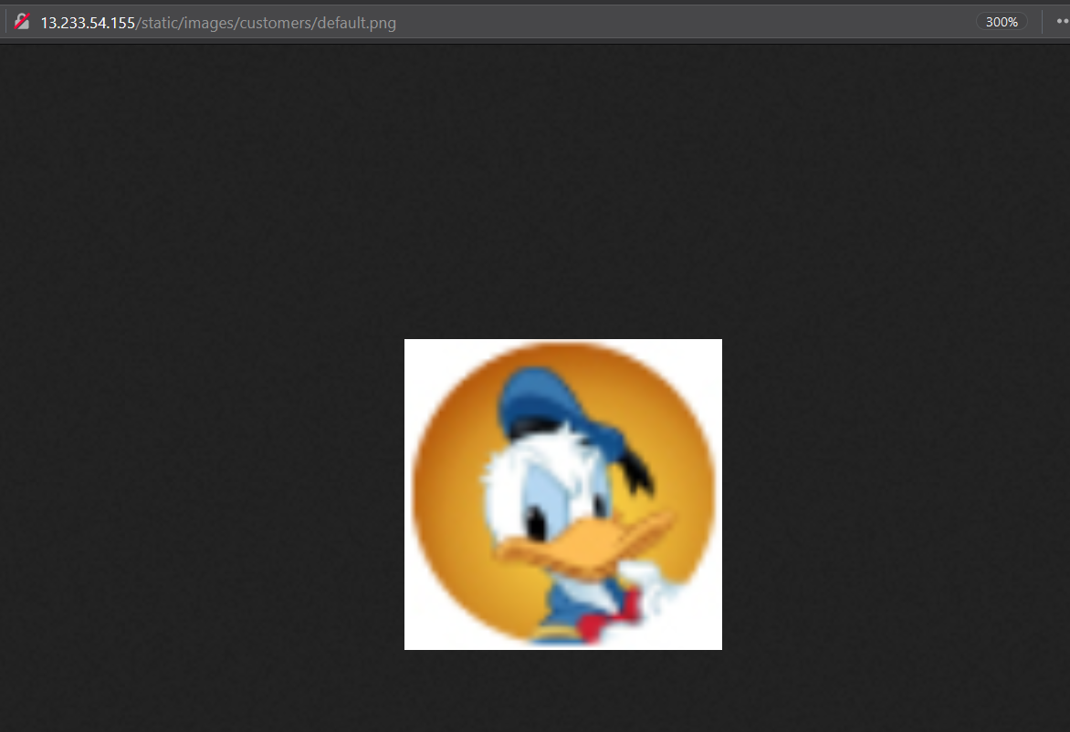
Observation
Navigate to mentioned URL
And you can see the whole path where everyone photo is stored.

Slide 98
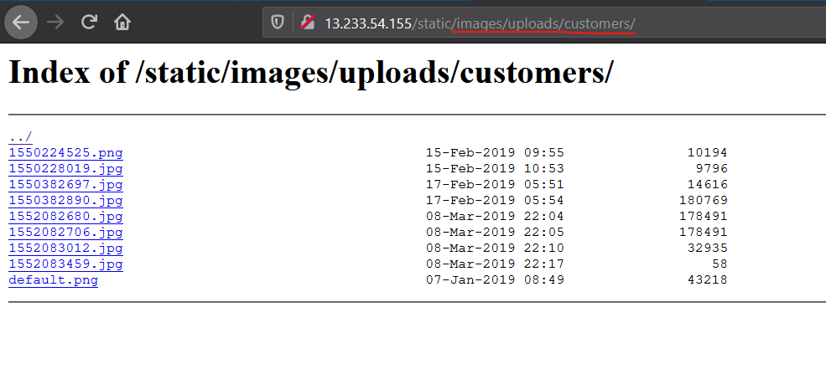
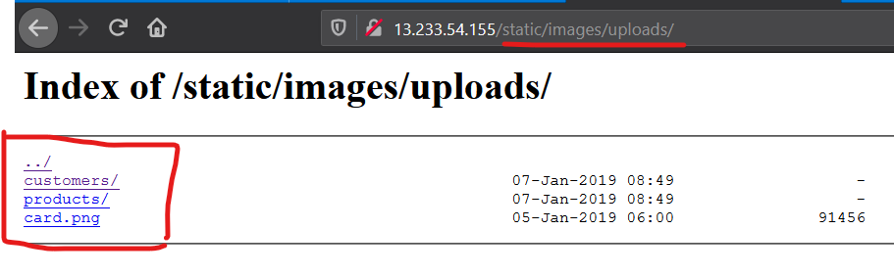
Proof of Concept (PoC)
Here if you see the URL, you will know that we just changed it little bit and we hit jackpot where we can see photos uploaded by customer and many more.

Slide 99
Business Impact - Moderate
Although this vulnerability does not have a direct impact to users or the server, though it can help the attacker in mapping the personal information of any account and plan further attacks on any specific account.
Recommendations
You can apply encryption to the personal data.
You can add authenticity and authorization to access the other data.

Slide 100
References
https://www.titanfile.com/blog/case-of-confidential-information-leak/
https://blog.logsign.com/information-leakage-of-threat-intelligence-incident-data-and-status-data/

Slide 101
14. Client Side and Server Side Validation Bypass
Client Side and Server Side Validation Bypass (Low) | Below mentioned URLs, we can easily bypass client side and server side validation Affected URL : http://13.233.54.155/profile/16/edit/ Affected Parameters : Contact Number (POST parameter) Payload: 1234658900000

Slide 102
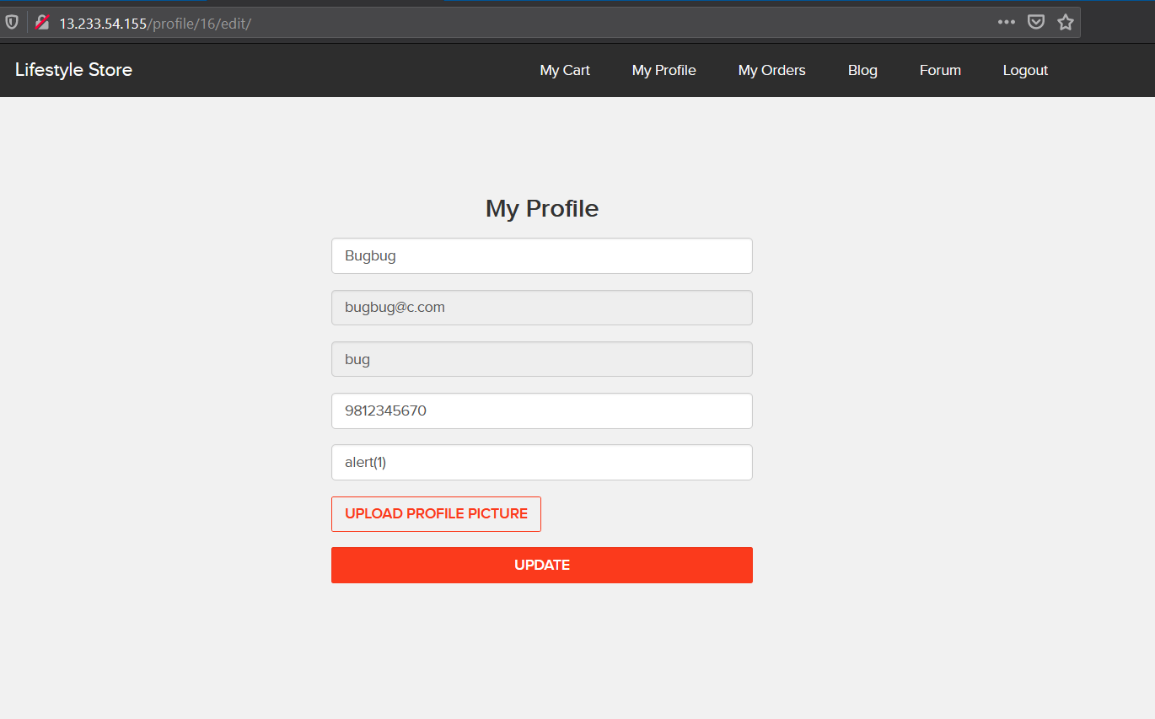
Observation
Here we intercepted the request and made changes in the contact number field.

Slide 103
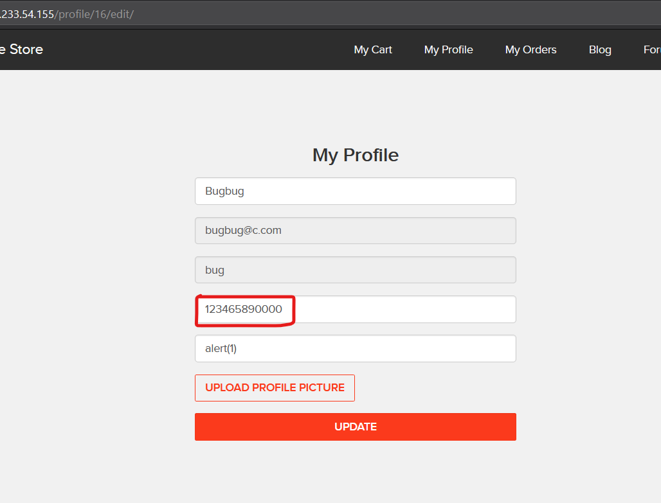
Proof of Concept (PoC)
Mobile number is changed and saved as 123465890000

Slide 104
Business Impact - Moderate
The data provided by the user, if incorrect , is not a very big issue but still must be checked for proper validatory information.
Recommendations
Implement all critical checks on server side code only.
Client-side checks must be treated as decoratives only.
All business logic must be implemented and checked on the server code.

Slide 105
References
https://cwe.mitre.org/data/definitions/20.html
https://www.owasp.org/index.php/Unvalidated_Input
https://www.whitehatsec.com/glossary/content/input-validation

Slide 106
THANK YOU
For any further clarifications/patch assistance, please contact:
Shivank.udaywal@gmail.com
8130207825

